Slide 1

Strategic Thinking
Welcome Team 2
2022455 | Ana Isabel Nieves Barcenas
2022461 | Karla Carolina
2022207 | Daniela Daia
2022175 | Rochana Matos
2022151 | Magdalene Ejiro
LECTURER | JAMES GARZA

Slide 2

Business Understanding
STRATEGIC THINKING
You can describe the business’s mission here. A clear message is a really good way to reach your audience

Slide 3



Business Description
STRATEGIC THINKING
HYPOTESIS
GENERAL GOAL
SUCCESSFUL OUTCOME
You can talk about the actions here
You can talk about the actions here
You can talk about the actions here
You can talk about the actions here
You can talk about the actions here
You can talk about the actions here

Slide 4

Data Understanding
STRATEGIC THINKING
DATASET
The Impact of Feedback: Which factors do employees look for in Company Reviews?
SHAPE
5 rows x 24 columns
ATTRIBUTES
Statistic, Month, Dwelling Status, Eircode Output, Stamp Duty Event, Type of Buyer, Unit, Value.

Slide 5

Technologies & Methodologies
STRATEGIC THINKING
Crisp DM Methodology
Jupyter Notebook and Python
Pandas Numpy Seaborn Matplot SkLearn
Random Forrest

Slide 6
Accomplishments
STRATEGIC THINKING
THE DATASET
EDA
DATA PREPARATION
We were able to get a good idea of what the dataset is about.
Preformed EDA on our data to ascertain what the data might be able to tell us and also tell us where we might have problems.
Need to make sure we can use the data for our analysis.
Clean the data
Resize the data
Feature Engineering
STATISTICAL ANALYSIS
FEATURE ENGINEERING
MODELING
We needed to preform some statistical analysis to give ourselves a better idea of what the data was telling us.
A lot of the data was in textual form, so some feature engine had to be preformed to make it useful.
We attempted two Machine Learning models to see if we could make some predictions.
Random Forrest

Slide 7

Data Preparation
STRATEGIC THINKING
Cleaning Data
Resizing of Data
Feature Engineering

Slide 8
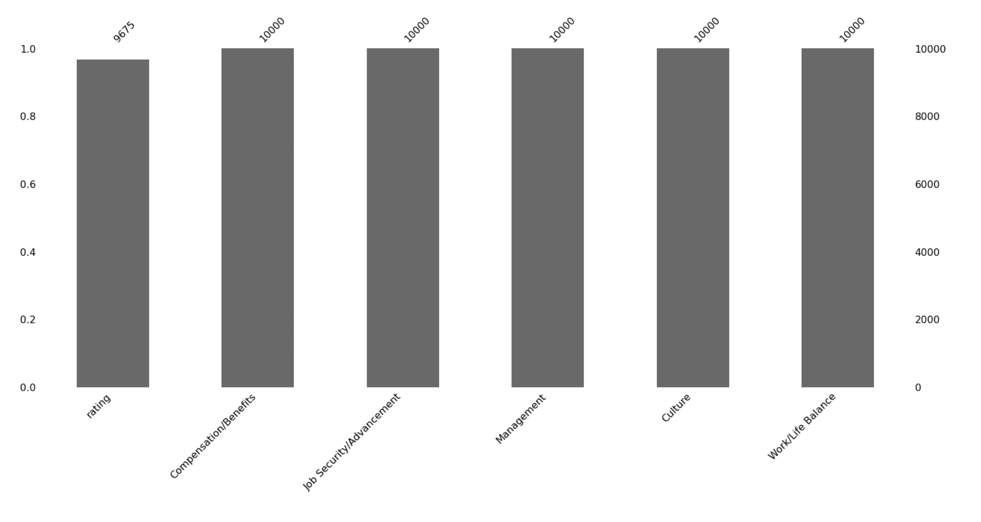
Descriptive Statistics
STRATEGIC THINKING

Slide 9

Challenges with the data
STRATEGIC THINKING
Size of the dataset
Sparse Data after encoding
Figuring out what model might work best for our dataset
Categorizing the symptoms as they are text based descriptions
Preparing and Cleaning the data
There is a lot of missing data

Slide 10

Results
STRATEGIC THINKING
Model Precision
Accuracy Score of 99.87
Model is over fit
So far this has been our best prediction score.
More work needs to be done to get a result we can have confidence in.

Slide 11
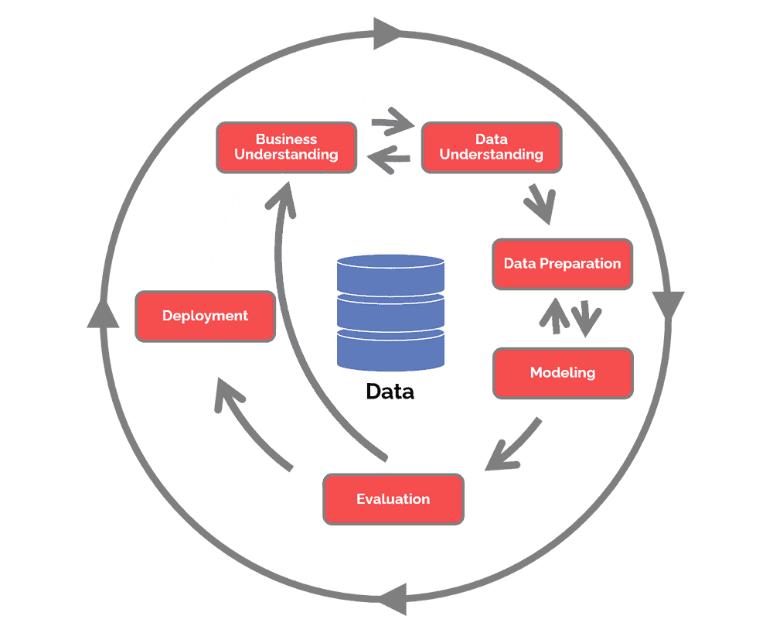
Next Steps
STRATEGIC THINKING
Evaluate
The next phase in the Crisp DM model is the evaluation stage.
So far using Random Forrest as our Machine Learning model has given the best scores.
However, our results are still not good enough.
So, we must re-evaluate to see what else can be done to improve our predictions.

Slide 12

Conclusion
STRATEGIC THINKING
We have outlined how using the Crisp DM data modelling process, we intend to complete this project.
Starting with the Business Understanding we have worked our way through the Data Understanding, Data Preparation, and Modelling phases. Next up the Evaluation stage.
We may have to tweak a few things or we may have to go back to the start but we are on a good trajectory.

Slide 13
Thanks!
Team 2

